Slide 1

画表情包
Ablock创客教育
Notes:
更多模板请关注：https://haosc.taobao.com

Slide 2
目录
CONTENTS
01
Part one
知识回顾
02
Part two
画表情包
03
Part three
拓展

Slide 3
01
Part one
知识回顾

Slide 4

知识回顾
命令 | 说明
turtle.backward (distance) | 向当前画笔反方向移动distance像素长度
turtle.forward(distance) | 向当前画笔方向移动distance像素长度
turtle.right(degree) | 顺时针移动degree°
turtle.left(degree) | 逆时针移动degree°
turtle.pendown () | 落笔
turtle.penup () | 抬笔
turtle.goto(x, y) | 将画笔移动到坐标x，y的位置
turtle.circle(radius, angle) | 画圆，参数1为半径，参数2为弧度
turtle.setheading(angle) | 设置画笔朝向为angle角度

Slide 5
知识回顾
命令 | 说明
turtle.pensize(size) | 设置画笔的粗细
turtle.fillcolor(colorstr) | 绘制图形的填充颜色
turtle.pencolor(colorstr) | 绘制图形的画笔颜色
turtle.color(color1, color2) | 同时设置pencolor=color1,fillcolor=color2
turtle.begin_fill() | 准备开始填充图形
turtle.end_fill() | 填充完成

Slide 6
知识回顾
命令 | 说明
turtle.clear() | 清空窗口，但turtle的位置和状态不会改变
turtle.reset() | 清空窗口，重置turtle状态为起始状态
turtle.setup(w,h, startx, starty) | 设置画布大小
turtle.screensize(w, h, bg) | 设置画布大小，参数分别为画布的宽(单位像素), 高, 背景颜色
turtle.setpos(x, y) | 移动到x，y位置
turtle.speed(speed) | speed为0-10的整数(1-10越来越快,0表示最快
turtle.shape(name) | 设置画笔形状，arrow|turtle|circle|square|triangle|classic
turtle.hideturtle() | 准备开始填充图形
turtle.showturtle() | 填充完成

Slide 7
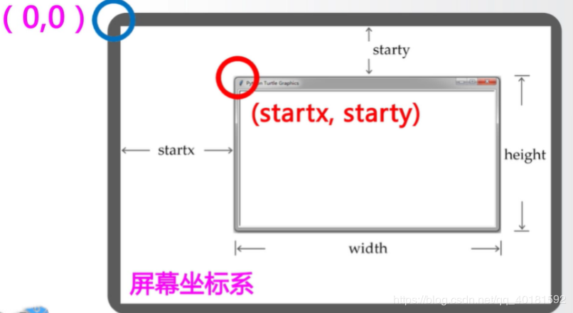
知识回顾

Slide 8
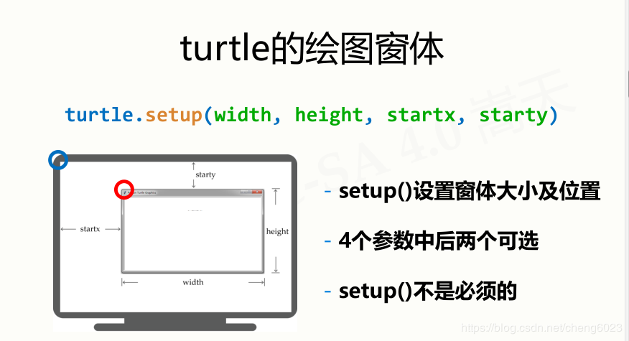
知识回顾

Slide 9
02
Part two
画表情包

Slide 10

画表情包
1.画头部
2.画嘴巴
3.画眼睛
4.画眼球

Slide 11
画大白
如何画头部
import turtle
turtle.setup(1200,900,0,0)
turtle.screensize(1200,900,"#ccffff")
turtle.speed(3)
turtle.shape("turtle")
turtle.color("orange", "yellow")
turtle.begin_fill()
turtle.circle(160)
turtle.end_fill()

Slide 12
画大白
如何画嘴巴
turtle.color("brown")
turtle.penup()
turtle.goto(-70,80)
turtle.seth(-55)
turtle.pendown()
turtle.circle(90,110)

Slide 13
画大白
如何画眼睛|左眼
turtle.penup()
turtle.goto(-55,180)
turtle.seth(0)
turtle.pendown()
turtle.color("brown","white")
turtle.begin_fill()
turtle.circle(35)
turtle.end_fill()

Slide 14
画大白
如何画眼睛|右眼
turtle.penup()
turtle.goto(55,180)
turtle.pendown()
turtle.color("brown","white")
turtle.begin_fill()
turtle.circle(35)
turtle.end_fill()

Slide 15
画大白
如何画眼球|左眼球
turtle.penup()
turtle.goto(-55,200)
turtle.pendown()
turtle.color("black")
turtle.dot(40)

Slide 16
画大白
如何画眼球|右眼球
turtle.penup()
turtle.goto(55,200)
turtle.pendown()
turtle.color("black")
turtle.dot(40)

Slide 17
03
Part three
拓展

Slide 18
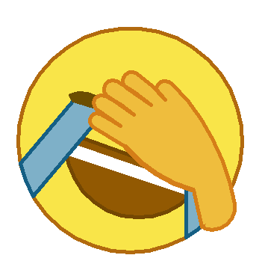
拓展
画出下图中的表情包

Slide 19
拓展
import turtle
turtle.clear()
turtle.reset()
turtle.speed(5)
#画脸
turtle.setup(900,600,200,200)
turtle.pensize(5)
turtle.right(90)
turtle.penup()
turtle.fd(100)
turtle.left(90)
turtle.pendown()
turtle.begin_fill()
turtle.pencolor("#B26A0F") turtle.circle(150)
turtle.fillcolor("#F9E549") turtle.end_fill()

Slide 20
拓展
#画嘴
turtle.penup()
turtle.goto(77,20)
turtle.pencolor("#744702")
turtle.goto(0,50)
turtle.right(30)
turtle.fd(110)
turtle.right(90)
turtle.pendown()
turtle.begin_fill()
turtle.fillcolor("#925902")#mouth color
turtle.circle(-97,160)
turtle.goto(92,-3)
turtle.end_fill()
turtle.penup()
turtle.goto(77,-25)

Slide 21
拓展
#画牙齿
turtle.pencolor("white")
turtle.begin_fill()
turtle.fillcolor("white")
turtle.goto(77,-24)
turtle.goto(-81,29)
turtle.goto(-70,43)
turtle.goto(77,-8)
turtle.end_fill()
turtle.penup()
turtle.goto(0,-100)
turtle.setheading(0)
turtle.pendown()

Slide 22
拓展
#画左边眼泪
turtle.left(90)
turtle.penup()
turtle.fd(150)
turtle.right(60)
turtle.fd(-150)
turtle.pendown()
turtle.left(20)
turtle.pencolor("#155F84")
turtle.fd(150)
turtle.right(180)
position1=turtle.position()
turtle.begin_fill()
turtle.fillcolor("#7EB0C8")
turtle.fd(150)
turtle.right(20)
turtle.left(270)
turtle.circle(-150,18)
turtle.right(52)
turtle.fd(110)
position2=turtle.position()
turtle.goto(-33,90)
turtle.end_fill()

Slide 23
拓展
#画右边眼泪
turtle.penup()
turtle.goto(0,0)
turtle.setheading(0)
turtle.left(90)
turtle.fd(50)
turtle.right(150)
turtle.fd(150)
turtle.left(150)
turtle.fd(100)
turtle.pendown()
turtle.begin_fill()
turtle.fd(-100)
turtle.fillcolor("#7EB0C8")#tear color
turtle.right(60)
turtle.circle(150,15)
turtle.left(45)
turtle.fd(66)
turtle.goto(77,20)
turtle.end_fill()

Slide 24
拓展
#画眼睛
turtle.penup()
turtle.pencolor("#6C4E00")#eye color
turtle.goto(-65,75)
turtle.setheading(0)
turtle.left(27)
turtle.fd(38)
turtle.pendown()
turtle.begin_fill()
turtle.fillcolor("#6C4E00")#eye color
turtle.left(90)
turtle.circle(38,86)
turtle.goto(position2[0],position2[1])
turtle.goto(position1[0],position1[1])
turtle.end_fill()

Slide 25
#画手
turtle.pencolor("#D57E18")#hand side color
turtle.begin_fill()
turtle.fillcolor("#EFBD3D")#hand color
#第一个手指
turtle.penup()
turtle.goto(110,-40)
turtle.seth(0)
turtle.left(-110)
turtle.fd(30)
turtle.pendown()
turtle.left(90)
turtle.circle(30,120)
turtle.circle(300,35)
turtle.circle(13,120)
turtle.setheading(-50)
turtle.fd(20)
turtle.setheading(130)
拓展

Slide 26
拓展
#第二个手指
turtle.circle(200,15)
turtle.circle(12,180)
turtle.fd(40)
turtle.setheading(137)
#第三个手指
turtle.circle(200,16)
turtle.circle(12,160)
turtle.setheading(-35)
turtle.fd(45)
turtle.setheading(140)

Slide 27
拓展
#第四个手指
turtle.circle(200,13)
turtle.circle(11,160)
turtle.setheading(-35)
turtle.fd(40)
turtle.setheading(145)
#第五个手指
turtle.circle(200,9)
turtle.circle(10,180)
turtle.setheading(-31)
turtle.fd(50)

Slide 28
拓展
#画最后手腕的部分
turtle.setheading(-45)
turtle.pensize(7)
turtle.right(5)
turtle.circle(180,35)
turtle.end_fill()
turtle.begin_fill()
turtle.setheading(-77)
turtle.pensize(5)
turtle.fd(50)
turtle.left(-270)
turtle.fd(7)
turtle.pencolor("#EFBD3D")
turtle.circle(30,180)
turtle.end_fill()

Slide 29
THANK YOU
教师：赵老师

